Slide 1


Discharge Process Workgroup
Michelle Hoehn, DNP, RN, NE-BC, CMSRN
Dr. Ferdinand Schafer
Julia Hunt, MSHAIL, CLSSGB, CCE

Slide 2
Agenda
KPI: % Out in 90 Minutes
Discharge Lounge Optimization
  Metric: % D/C lounge utilization
  Uber/ Lyft
  Discharge Lounge Criteria
Discharge/ Transfer flowcharts

Slide 3
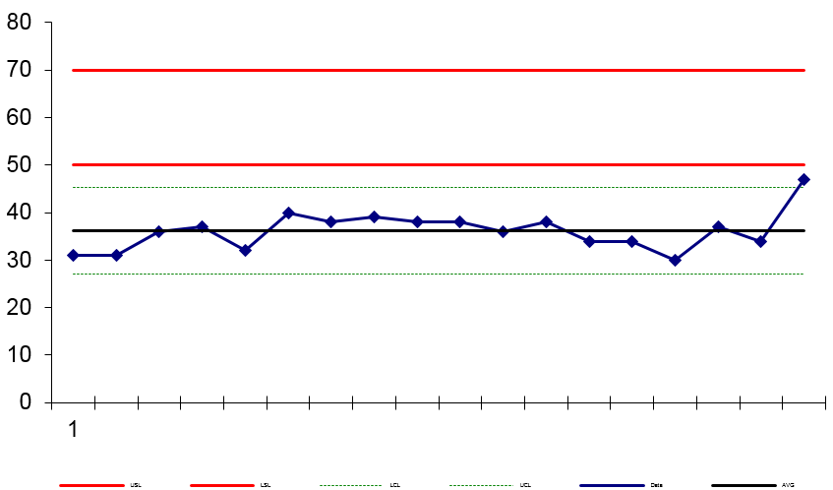
% Out in 90 minutes
Frequency: Weekly
Date: May 5, 2021

Slide 4
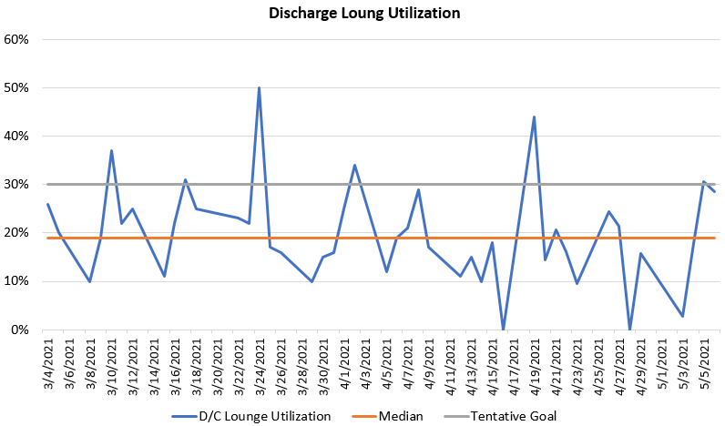
Discharge Lounge Optimization
Metric: % of eligible patients who went to the discharge lounge
Median: 19%
Goal: 30%

Slide 5
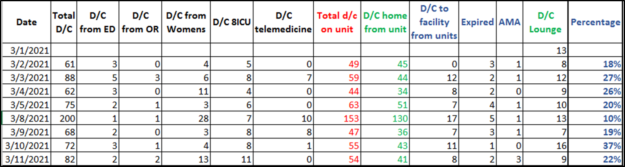
Discharge Lounge Optimization
Metric: % of eligible patients who went to the discharge lounge
Sample
Metric Calculation:
Total D/C – (ED+OR+Womens+8ICU+Telemed) = Total D/C from units eligible to use the D/C lounge
(Total sent to D/C lounge/Total to home from eligible units)x100= D/C lounge utilization percent

Slide 6
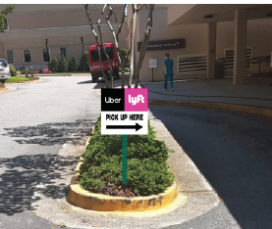
Discharge Lounge Optimization
Uber/ Lyft
Progress:
  POB 1 pickup location
  Mocked up uber/lyft pickup signs and received feedback regarding the new process from patient advisors
  Decision made to contract with Lyft using hospital credit card
Next Steps:
  5/14 meeting
  Determine best Lyft pickup timeframe - 30-45 minutes from discharge request?
  Review patient advisor questions/ comments for any additional changes to the process
  Finalize & order signs
  Contract with Lyft
MOCK-UP

Slide 7
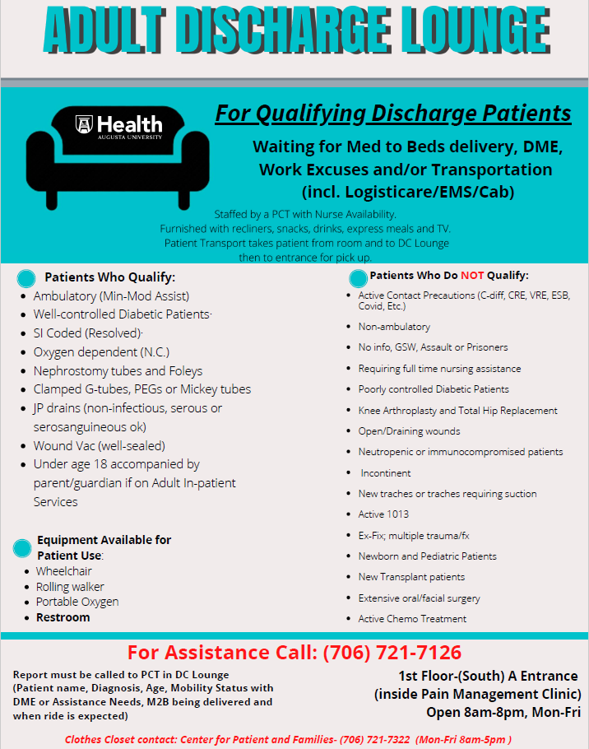
Discharge Lounge Optimization
Discharge Lounge Exclusion Criteria
Transplant
  Dr. Saeed toured/ approved the lounge
  Transplant team needs to ensure patient is ready to go before discharge
  5/13 meeting with transplant nursing leader
Knee/ Hip
  5/12 meeting w/ Ortho providers
CHOG 18 – 21 years
  Finalize work team and schedule meeting

Slide 8
Discharge Lounge Optimization
CHOG 18 – 21 years Team Members
    Michelle Hoehn
    Julia Hunt
    Kim Basso
    Christa Butler
    Gloria Wright
    Brittany Faulkner
    Amy Bales
    April Lewis
    Brittany Enfinger
    Alicia Fulghum
  Damian Priessman
  Venita Davis
  EVS - Ken Philibin
  Transport - Mark Stevens
  Nursing Supervisors
  Pharmacy (optional)
  Meds to Beds –
  PFCC –
  Nursing Education –

Slide 9
Discharge Lounge Optimization
Next Steps:
  D/c lounge flyer & clothes closet info will be added to admission packet
  Test opening d/c lounge on Saturday
  Conditional discharge order go live June 8th.

Slide 10
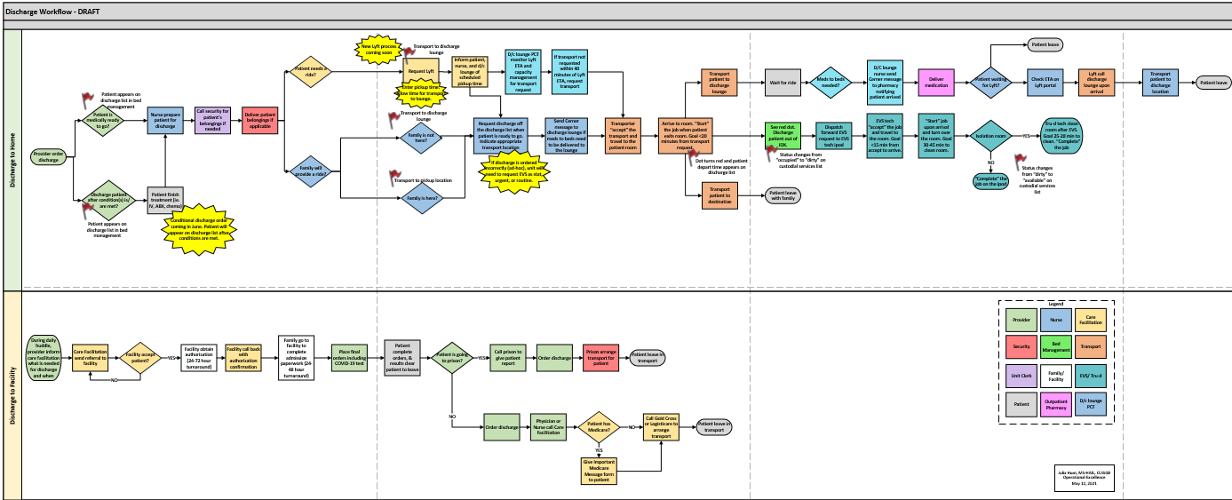
Discharge Flowchart

Slide 11
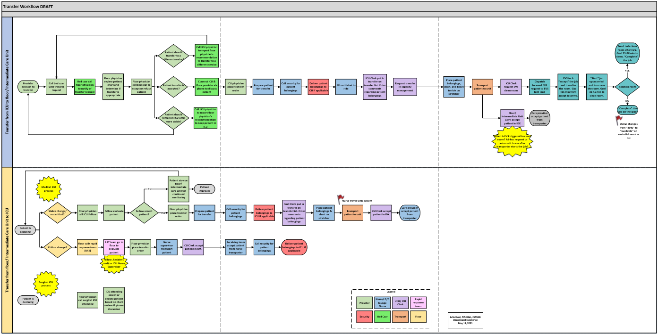
Transfer Flowchart

Slide 12
Questions or Comments

