Slide 1
Transforming Care at Augusta University Health
Cynthia Pruett, BBA, BSN, MBA, RN, NE-BC, RN-BC
Chief Nursing Information Officer
Michelle Hoehn, DNP, RN, NE-BC, CMSRN
Director of Adult Patient Care Services and Centralized Nursing Services
Lisa Gulker, DNP RN ACNP-BC
Senior Director, Health System Operations

Slide 3
Objectives
After attending this session, the participant will be able to:
Discuss the major health system market forces that are influencing leaders who manage resources for care delivery
Provide examples of how people, process, and technology can enable effective centralized clinical operations.

Slide 4
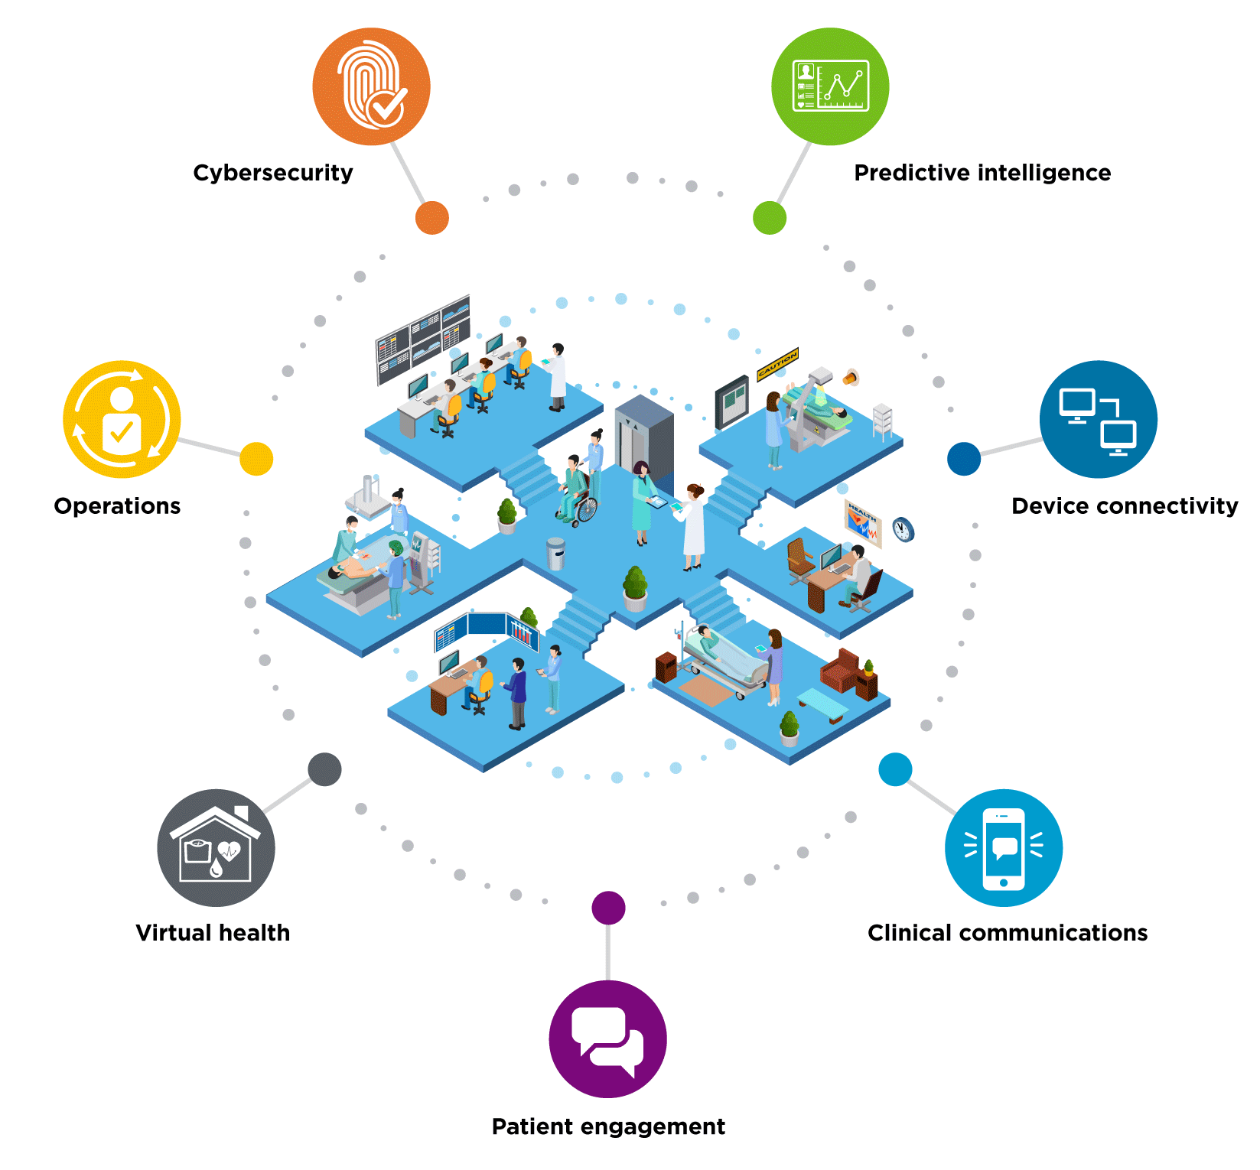
Real-Time Health System
A health delivery organization that leverages near-real time and predictive data from many sources to improve clinical, operational, and financial efficiency and effectiveness.
A real-time health system composes people, process, and technology into a unified and meaningful whole, enabling data-driven decisions and actions.
Notes:
Predictive intelligence: Uses data science and machine learning at scale to analyze, interpret and comprehend historical data to make predictions and inform future care
Device connectivity: Enables interoperability between medical devices, health care applications and the EHR, regardless of vendor.
Clinical communications: Brings together care team communications, clinical workﬂows and alarm management on one mobile device to improve efficiency and coordinate care.
Patient engagement: Streamlines behind-the-scene activities to promote greater efficiencies and provide an enhanced user experience.
Virtual health: Provides care at a distance, using an ecosystem of virtual and remote services and technology to deliver quality cost-effective care anywhere.
Operations: Optimizes patient journey through health system, coordinating critical resources and a precision care team across the continuum.
Cybersecurity: Fortiﬁes your organization with a more protected and secure posture using a comprehensive cybersecurity approach.

Slide 5
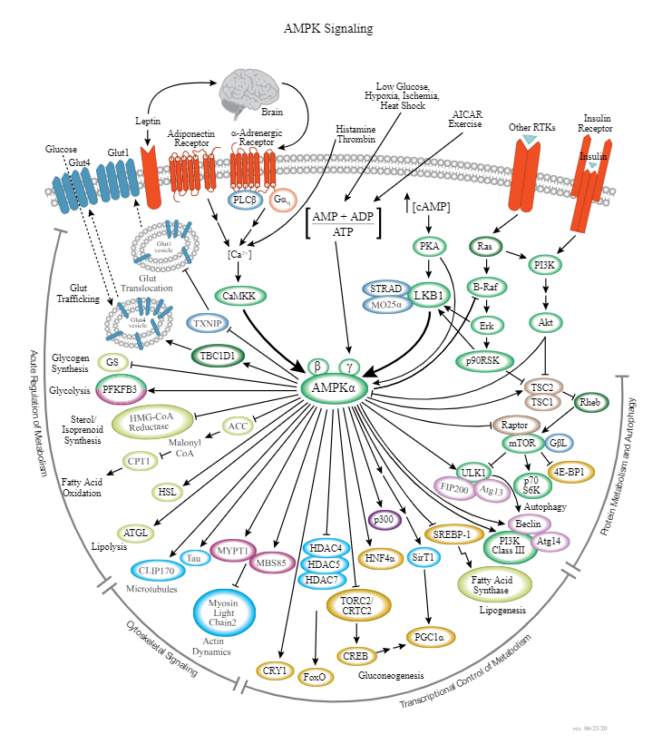
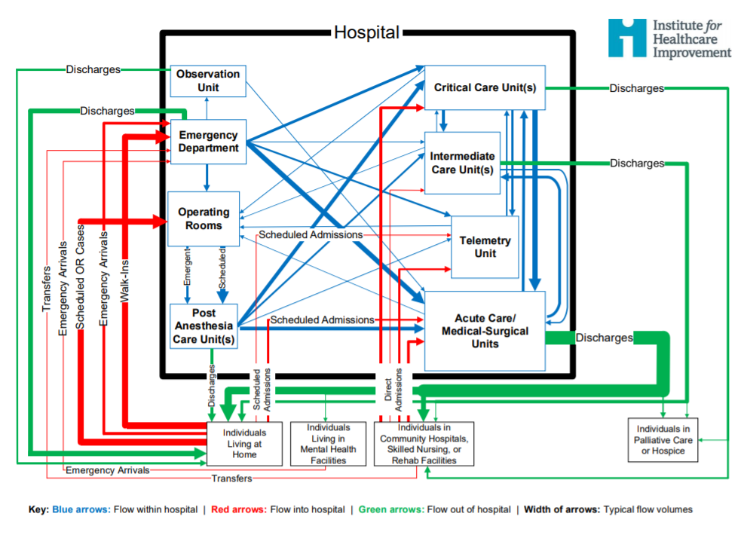
Health systems have a metabolism – they need to manage supply in order to meet demand
https://www.cellsignal.com/pathways/ampk-signaling-pathway
Accessed 1.20.21
http://www.ihi.org/resources/Pages/IHIWhitePapers/Achieving-Hospital-wide-Patient-Flow.aspx
Accessed 1.20.21

Slide 6
What will situational awareness mean in the next normal?
What are the new market forces we should consider?
Our care teams are essential, like oxygen, and they are precious.
Managing the flow of resources to meet the demand for care will require a digital ecosystem with embedded sensors in point of service workflows across the care continuum.
Predictive and prescriptive analytics – applied data science at scale – become essential tools for clinical operations (patient flow) teams.
Virtual health and home as a venue will remain part of the delivery network.

Slide 7

Transforming Care at
Augusta University Health

Slide 8

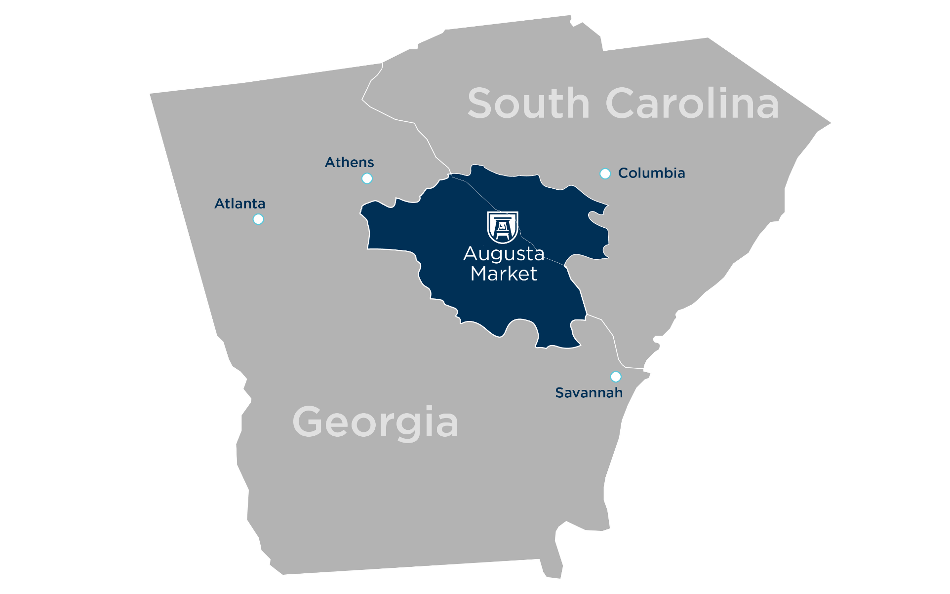

AU Health Overview
780K
Population in the Central Savannah River Area (CSRA), a region of Georgia and South Carolina
Academic
Medical Center
Regional
Level 1
Trauma Center
478
Bed Medical
Center
336,951
Clinic Visits
Founded in 1828
9 Colleges & Schools
132 Academic Programs
$1.3 Billion Budget
8,532 students
520
Residents/Fellows
154
Bed
Children’s Hospital
24,163
Surgical & Endoscopy
Cases
851 Attendings & APPs
14,377
Enterprise
Workforce
4,494
AU Health
workforce
83,860
Annual
ED Visits
1525
RNs
Home of the Master’s Tournament
Notes:
Cynthia to kick off with overview of Augusta University

Slide 9
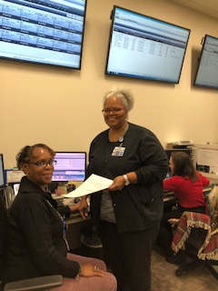
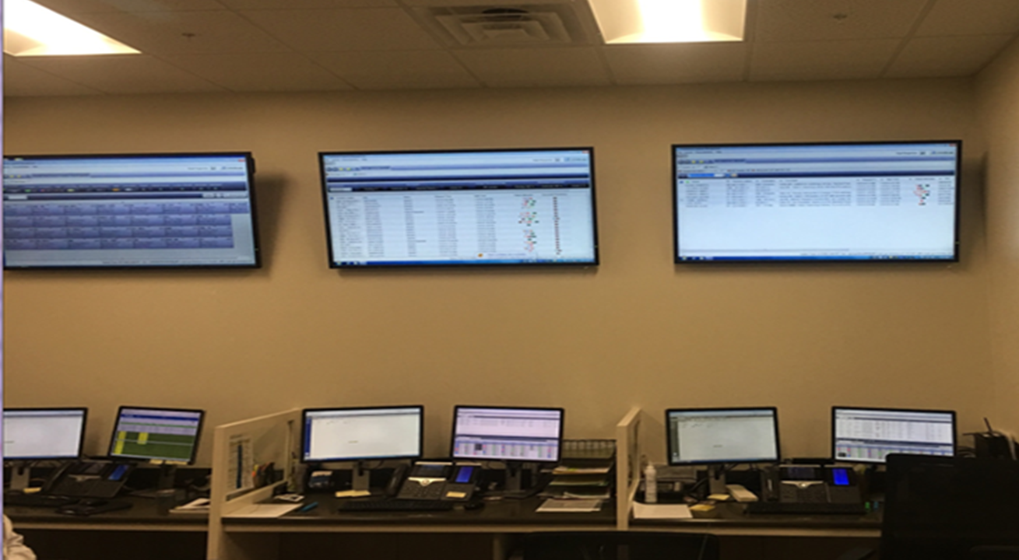
Command Center - Centralized Logistics Center
Nursing Supervisors
Centralized Staffing Office
Discharge
Nurses
Patient Observer
Transfer Center
Bed Czar
Bed Management
Float Pool Assignments
Enterprise Throughput
  Multiple departments in centralized location
  Improve communication between departments
  Drives coordinated processes: patient placement, staffing resources & solution costs

Slide 10
Timeline of Events
February 2016
Throughput Dashboard finalized and
distributed monthly
January
2015
Care Facilitation Initiative Begins
January
2017
ED Provider Triage &
Rapid Treatment Area
May
2018
Interdisciplinary Huddles &
CDI
Rounding
on units
October
2015
Nursing Command Center
November
2017
Patient
Observer
Go Live
December
2018
Hospital Wide Surge Plan
August
2016
Clairvia
Go
Live
March
2018
Geo-Wards
Go Live
April
2015
Patient Flow System Implementation begins
November
2016
Adult
IMC
May 2016
Care Facilitation Department
Go Live
October
2017
Transfer
Center
Go Live Command Center
February
2018
Eliminated
Bedded
Outpatients
April
2018
ED FastTrack
Expanded
June
2018
New ED Admission Process
September 2019
Nursing Supervisor Coverage Increased
December 2015
Patient
Flow
System
Go Live &
8South opened
Notes:
Cynthia to talk about vision for Command Center and highlighting the implementation of CapMan, Clairvia, Patient Observer and Transfer Center (Cerner development partner)

Slide 11
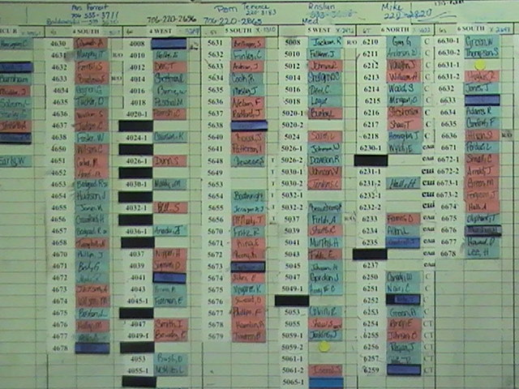
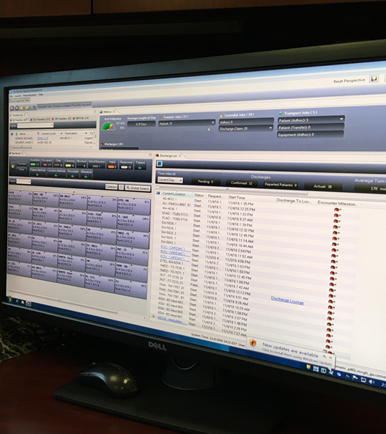
Power of the New System
The images below highlight the huge improvement the new electronic bed management system provides to AU Health
Pre-Capacity Management Patient Flow:
Manual Bed Tracking and Placement
Post-Capacity Management Patient Flow:
Automated Bed Tracking and Placement

Slide 12
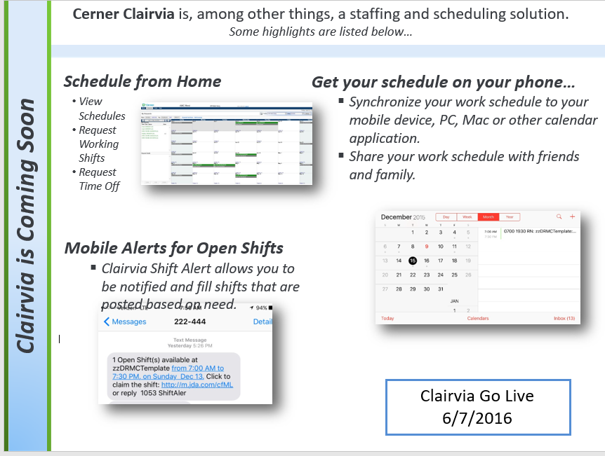
Clairvia Go Live 2016

Slide 13
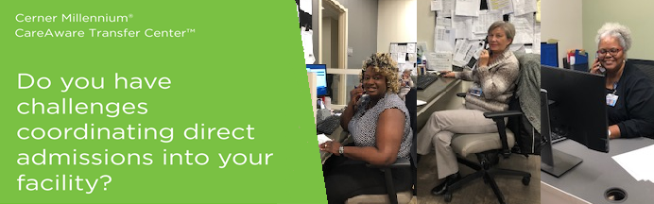
Cerner Transfer Center
Key Benefits
Designed to seamlessly track all communications associated with a case
Helps manage transfer center admits more efficiently by compiling all necessary documentation in one core solution.
Helps manage the stream of patients arriving to the facility, avoiding unnecessary ED visits
AU Health is a Development Partner
Nurses on recorded line with transferring facility and physicians
Nurses can listen to physician to physician call to add additional information
Transfer nurse is knowledgeable of bed status so can update requesting facility on status of transfer (located in Command Center)
After patient is accepted nurse will enter info into InterQual to determine eligibility and correct patient status
.

Slide 14
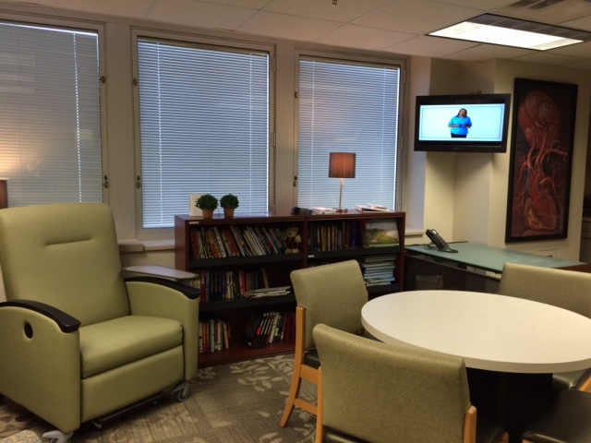
Discharge Lounge Supports Throughput
Comfortable place to await transportation home
Increase bed turnaround
Decrease ED wait time

Slide 15

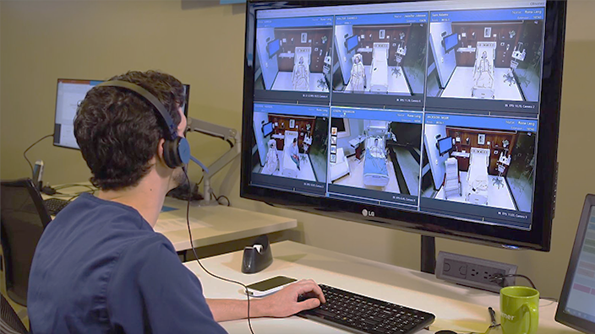
Cerner Patient Observer
Visualization of and Communication with Patient
Reduces Sitter Utilization
Reduction of Falls with Injury

Slide 16
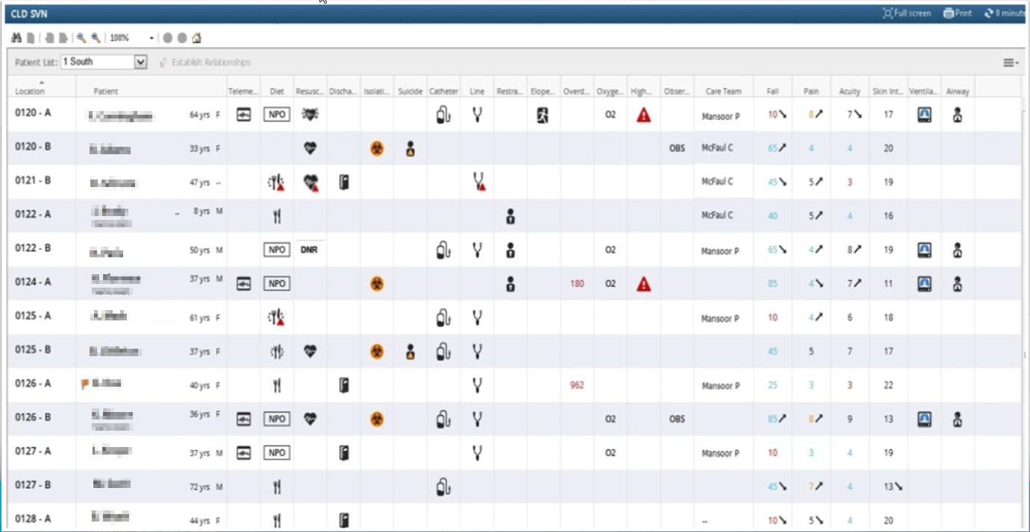
Cerner Clinical Leader Organizer
Go-Live date January 2017
Provides detailed quality metrics
Utilized by Clinical Outcomes Managers
Enhances patient quality outcomes
Notes:
Cynthia

Slide 17
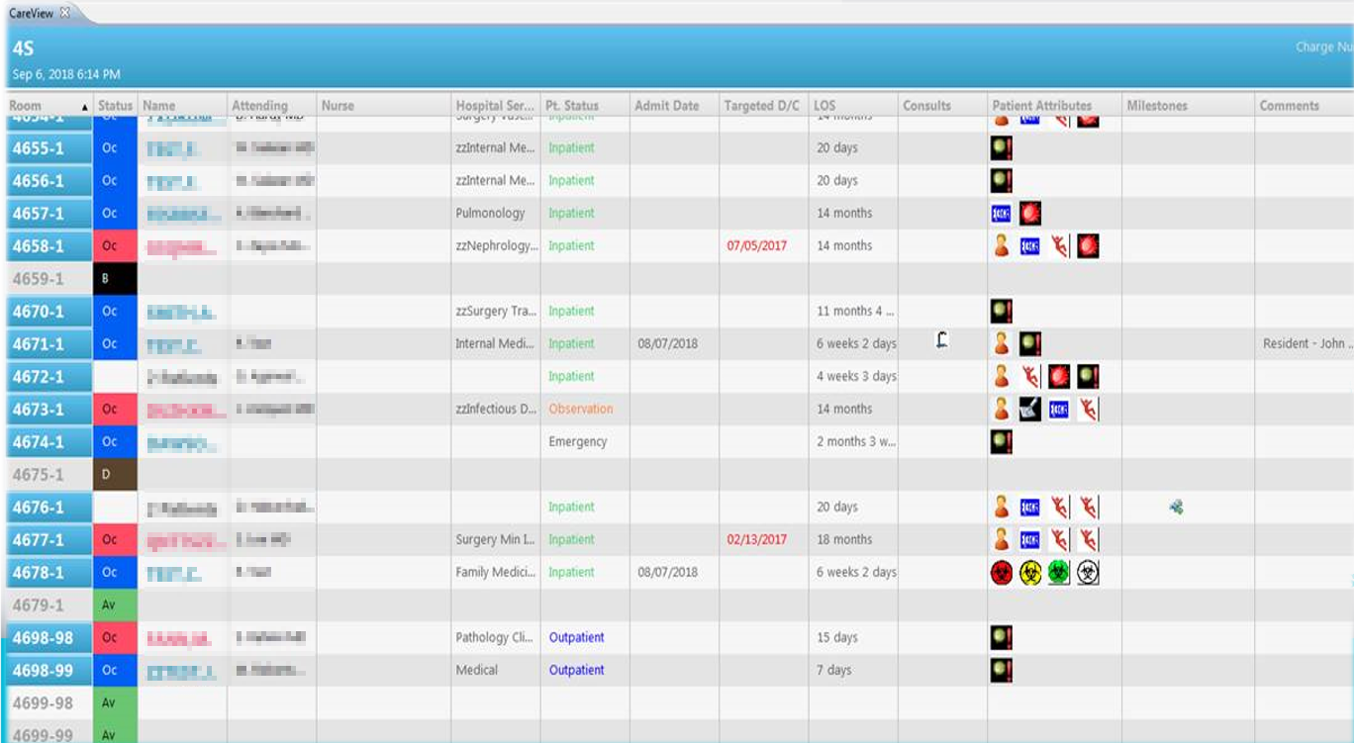
CareAware CareView Dashboard
Go Live 11/12/2018
Replacing current patient flow dashboard
Real time information displaying color coded patient status
Integrates with orders to display patient attributes and with Clairvia to display nurse assignment
Highly effective for the interdisciplinary huddles

Slide 18
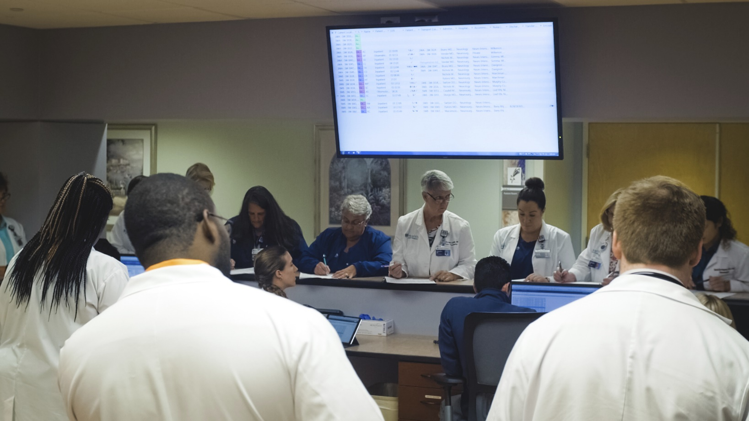

3 West Patient Flow Daily Huddle
Real time bed status
Transfer Orders
Discharge Status
Barriers to Discharge
Meds to Bed

Slide 19


Hospital Wide Surge Plan - Interventions
Evaluate current staffing
For ED: Maximize capacity of both Emergency Departments
For ED: Setting up a quick dispo station
Nursing Supervisor to operate out of area of surge until clear
Increase focus on rounding / discharge rounds
Rapid push to D/C Lounge
Activate emergency bed huddle
Hallway patients ok on inpatient floor if bed is dirty/discharging (OOPS done)
Radiology/ Lab prioritizes discharging patients / or ED patients
EVS prioritizes D/C versus general clean
Rapid maintenance issues prioritized
Standing up overflow areas in Radiology OBS / PPC / 8West
Canceling meetings
Evaluate elective surgeries
Diversion evaluation
CEPAR assistance

Slide 20


The Ultimate Test
Hurricane Matthew
October 2016
Hurricane Michael
September 2018
Hurricane Dorian
September 2019
Hurricane Irma
September 2017
Hurricane Florence
October 2018
COVID Pandemic
March 2021
Able to provide real time data for hospital capacity and staffing to aid in placing evacuated patients and to support increased demand from COVID 19 Pandemic
Notes:
Cynthia

Slide 21
AU Health Transfer Center

Slide 22
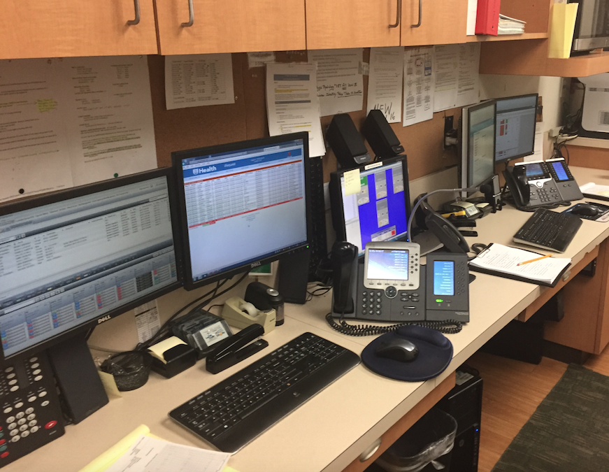
Previous Workflow:
Emergency Communications Center
Notes:
All of AUMC communication came through our Emergency Communications Center (ECC). The ECC was created at the end of 2000 with minimal staff and equipment. In 2001 the ECC coordinated an average of 231 transfer calls per month. In 2017, the ECC handled 638 request for transfers. The complexity and additional duties surrounding the transfer of these patients has also increased. The volume continued to increase and was over 850 transfer calls per month. The mismatch between work load and available resources to coordinate these transfers has resulted in a degradation of customer service and responsiveness and resulted in errors impacting patient care. Additionally the transfer of patients requires extensive coordination between the transferring facility, the ECC, Care Facilitation, and Bed Management. The lack of co-location of the ECC and Bed Management adds additional inefficiencies to the coordination for transfers.

Slide 23
Previous Workflow:
ECC Trend
Notes:
Besides the increase in transfer volume, the ECC has grown from 5429 calls per fiscal year to 7143 calls per fiscal year. The number of calls the ECC is receiving is becoming overwhelming and EMS operators are unable to keep up with the number of calls. This can lead to missed calls or transfer opportunities.
ECC staff other duties include:
EMS Radio
Incoming emergent alerts (Code Stroke, Code Blue, Trauma, STEMI, etc.)
EMS Field EKG receiving center
Coordination of disaster notifications
ED to ED emergent transfer coordination
Competing duties of ECC personnel results in delays including:
Missed EMS calls / inaccurate information relayed
Delays in answering transfer calls
Errors in documenting due to interruptions

Slide 24

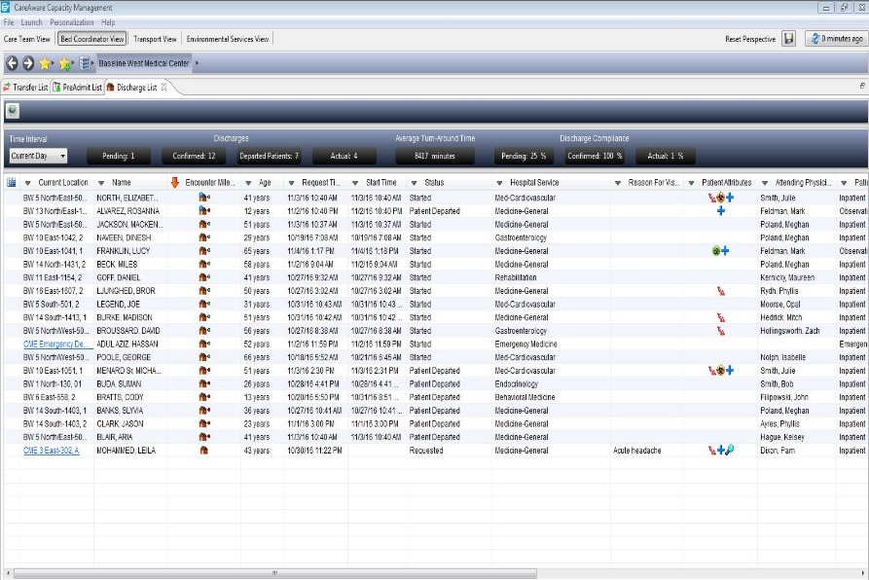
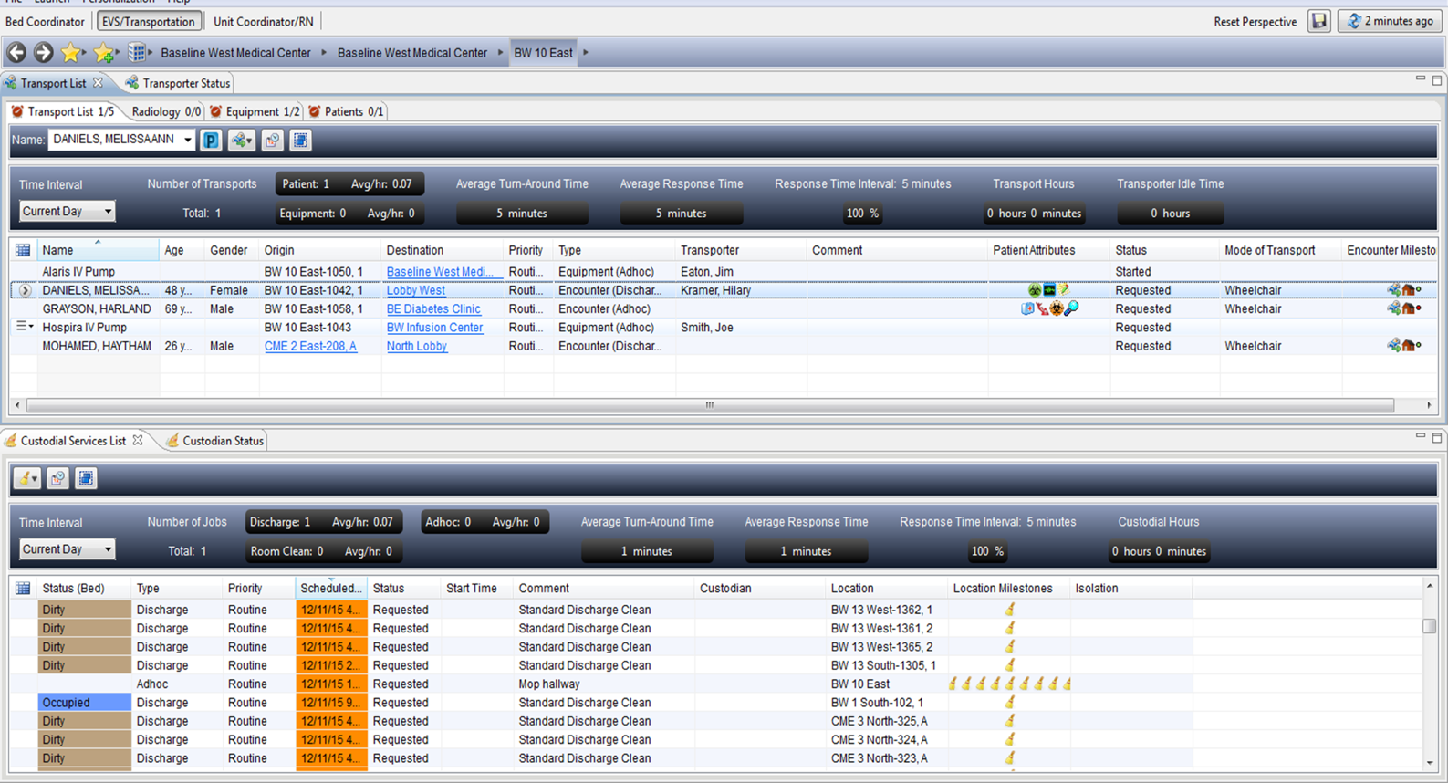
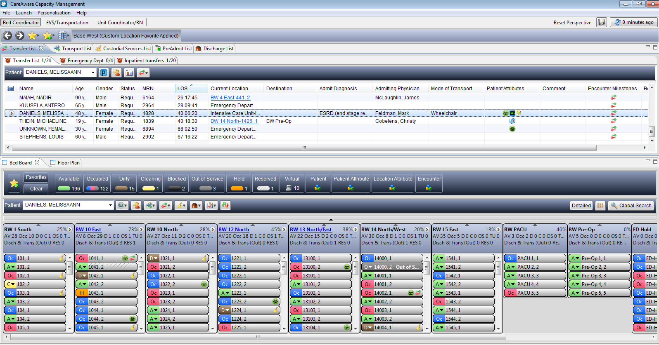
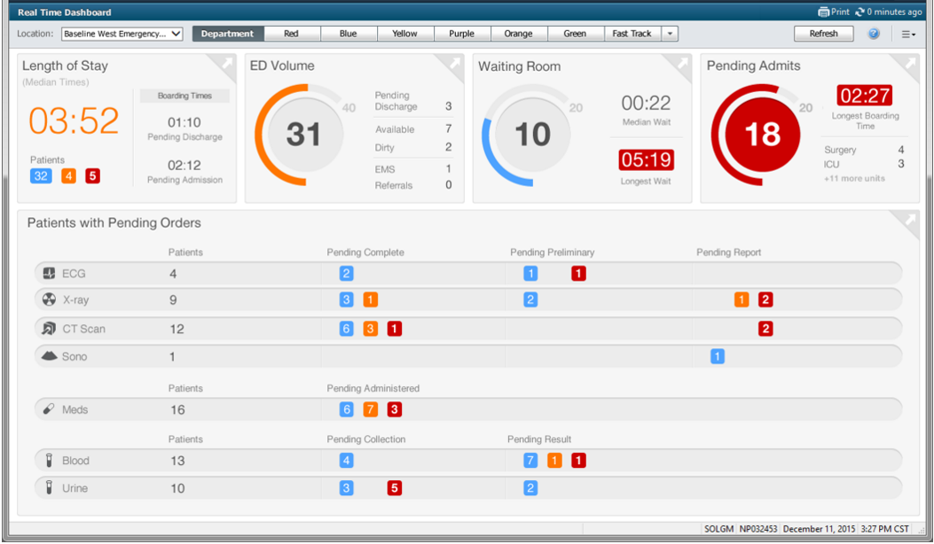
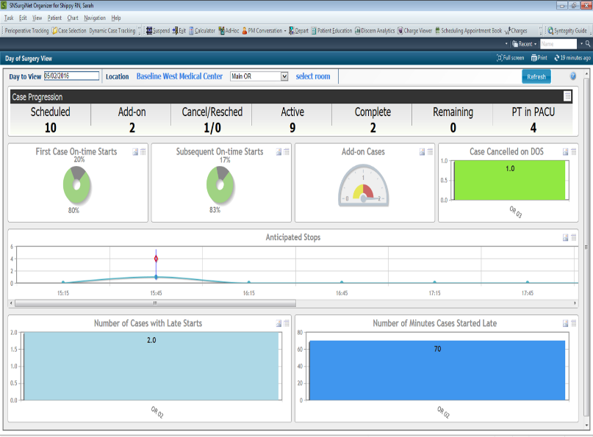
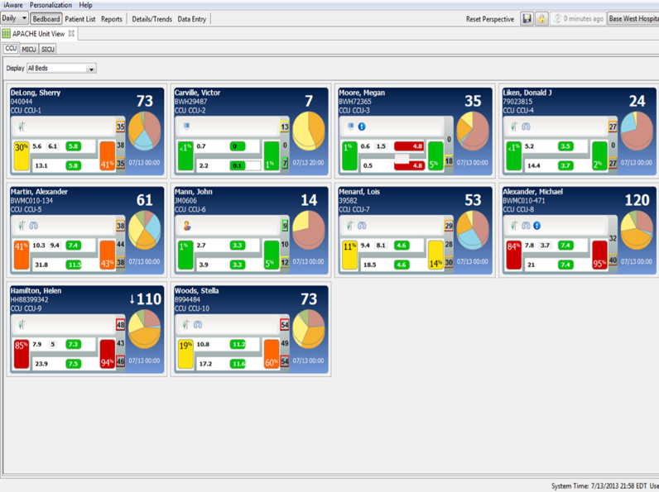

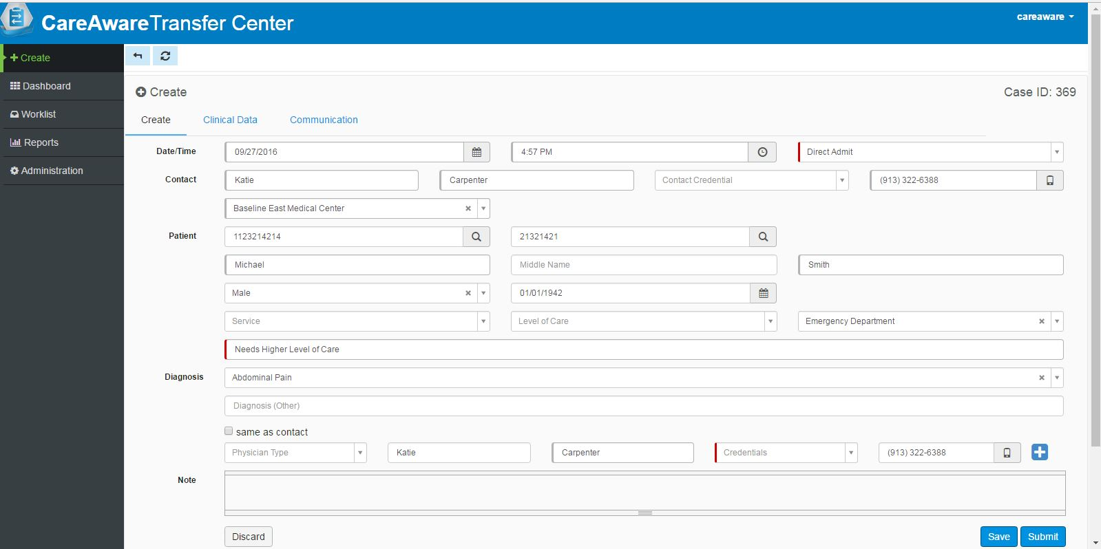
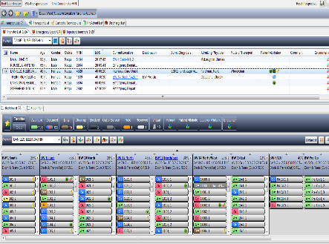
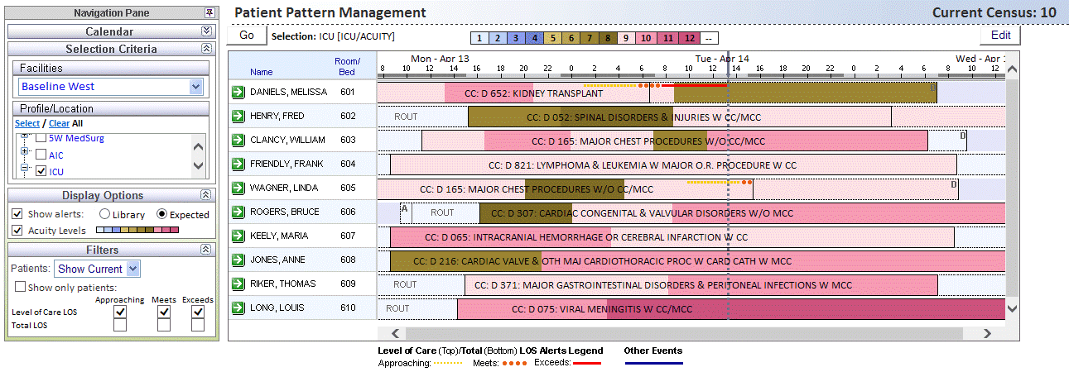
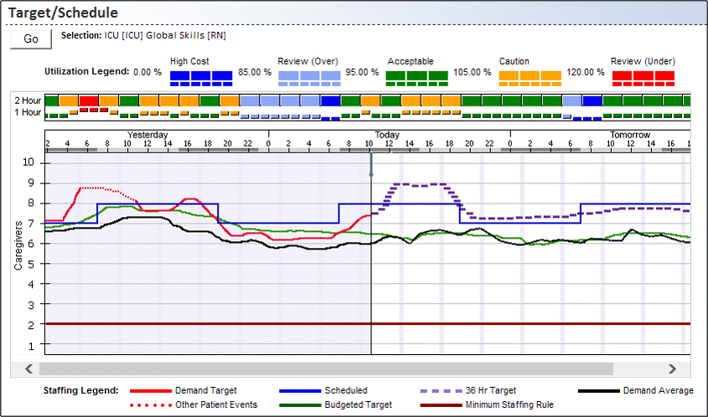
Capacity Management
Venues
Discharge List
EVS & Transport
Bed
Management
Surgery
ED
ICU
Transfer Center
Bed Board
Patient Progression
Predictive Staffing
Staffing
And
Workforce Management
Notes:
Cerner’s Command Center Design. We saw this after we built our Command Center, however the designs are almost exactly the same.

Slide 25
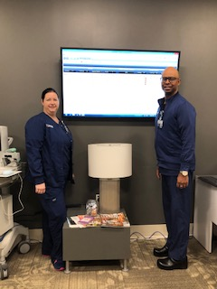
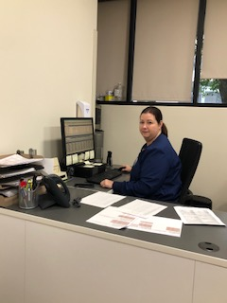
Nursing Supervisor Coverage – Sept. 2019
  Better view on throughput and issue resolution
  2nd Supervisor acts more as a resource nurse
  Offers better support to the ED after hours
  Rapid Response Team has better around the clock coverage
  Better response to Code Blue, Code Heart, in house STEMI Alerts and Code Strokes

Slide 26
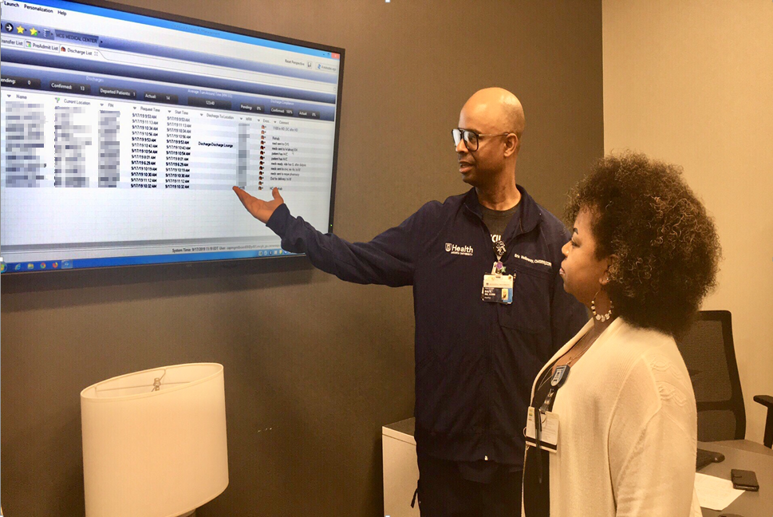
Bed Czar
Located in the Command Center
Oversees patient flow throughout the hospital
Continuously updating plan based on flow of ED, Clinics, Transfer Center, and Surgical patients.
Forecast bed assignments and discharges to create capacity
Coordinates with Nursing Supervisors, Bed Management, ED, PACU, and Transfer Center
Coordinator for hospitalist and academic medicine patient assignments
Estimates discharge times by coordinating with Discharge Lounge nurses
Escalates throughput obstacles to administration

Slide 27
Mission of the Transfer Center
Provide a comprehensive, centralized, single-call service for all transfers and consults
  Part of Bed Board – single point of assignment
  Staff Register Nurses
  Triage call and connect with appropriate faculty specialist (recorded call)
  Capture documentation to support transfer & admission information
  Coordinate with nursing unit and arrange for inpatient bed/ED
  Assist with transportation as needed
  Update referring physician/team until transfer is complete
Notes:
We proposed to create a centralized Transfer Center, co-located with the bed management office to add efficiencies and improved coordination of transfers between an outside facility/location and AUMC. The ECC would remain intact but would focus on EMS, ED to ED transfers, and Emergency Department communications. The new Transfer Center would be staffed by RNs with Case Management education and knowledge of nationally accepted criteria on medical necessity documentation to support levels of care. The desired outcome by having RNs in the Transfer Center/ Bed Management area would include increase our customer service, improve transfer coordination, reduce placement errors and ensure accepted admission are appropriate for an acute care setting.

Slide 28


Why use nurses?
Notes:
Benefits of having RNs in the Bed Management/Transfer Center Area:
Nurses will utilize their knowledge of medical necessity and Case Management to collaborate with the physician(s), to assess the patient transferring to AUMC.
Enhance the appropriateness of placement and connection with the service line in collaboration the physician(s), making sure patient is getting the right care in the right setting. The nurse will facilitate and screen for appropriate transfers and direct admits to the hospital. With the nurses additional training in Case Management we are ensuring the patients are getting the right care in the right setting. Time can be saved by reducing back and forth calls as more detailed clinical questions are asked and answered. Our nurses will have a better understanding of payer policies, reimbursement requirements, and an overall knowledge of healthcare regulations and compliance guidelines (protecting the patient, hospital and physicians). Understanding the different levels of care across the continuum, the nurse will know what services can be provided at the different levels, ensuring appropriate placement and reimbursement, and avoiding unwarranted cost to the patient if the plan of care does not require a higher level of care.

Slide 29
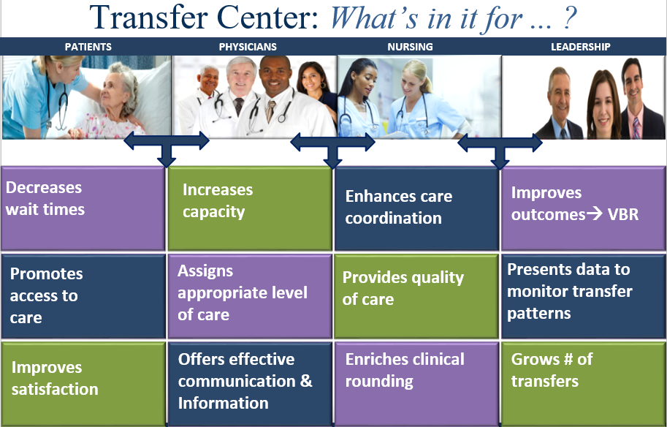

Slide 30
Financial Impact

Slide 31
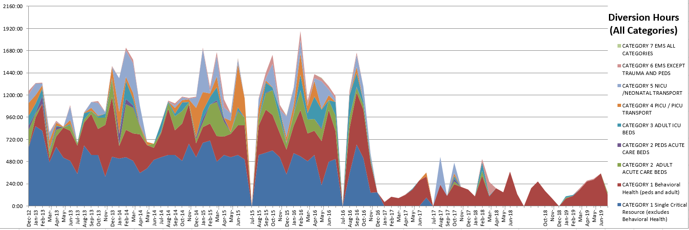
Key Performance Indicator: Transfer Diversions
Notes:
David

Slide 32

The Transfer Center is our handshake into the Health System,
and we only have one chance to get it right
Notes:
Thank you. Do you have any questions?

Slide 33
Patient Flow Dashboard – Initial Version
Throughput Dashboard was developed to track key metrics
Dashboard is distributed monthly
Visibility and transparency allows for a clear view of the organization’s current status along with accountability for each of the metric owners
Notes:
Cynthia
Rowena follows up on the dashboard monthly
Metrics are color coded
Manual process for entering data
Bed Request to Bed Assignment, Discharge Order to Discharge Complete Times, and ED Door to Admit/Door to Discharge Times
ALOS was selected as a joint decision with executive leadership, medical staff leadership, and steering committees
Selected because it addressed the pain points
Looking forward to the impact of Value Based Purchasing
Shows that resources are being utilized appropriately

Slide 34
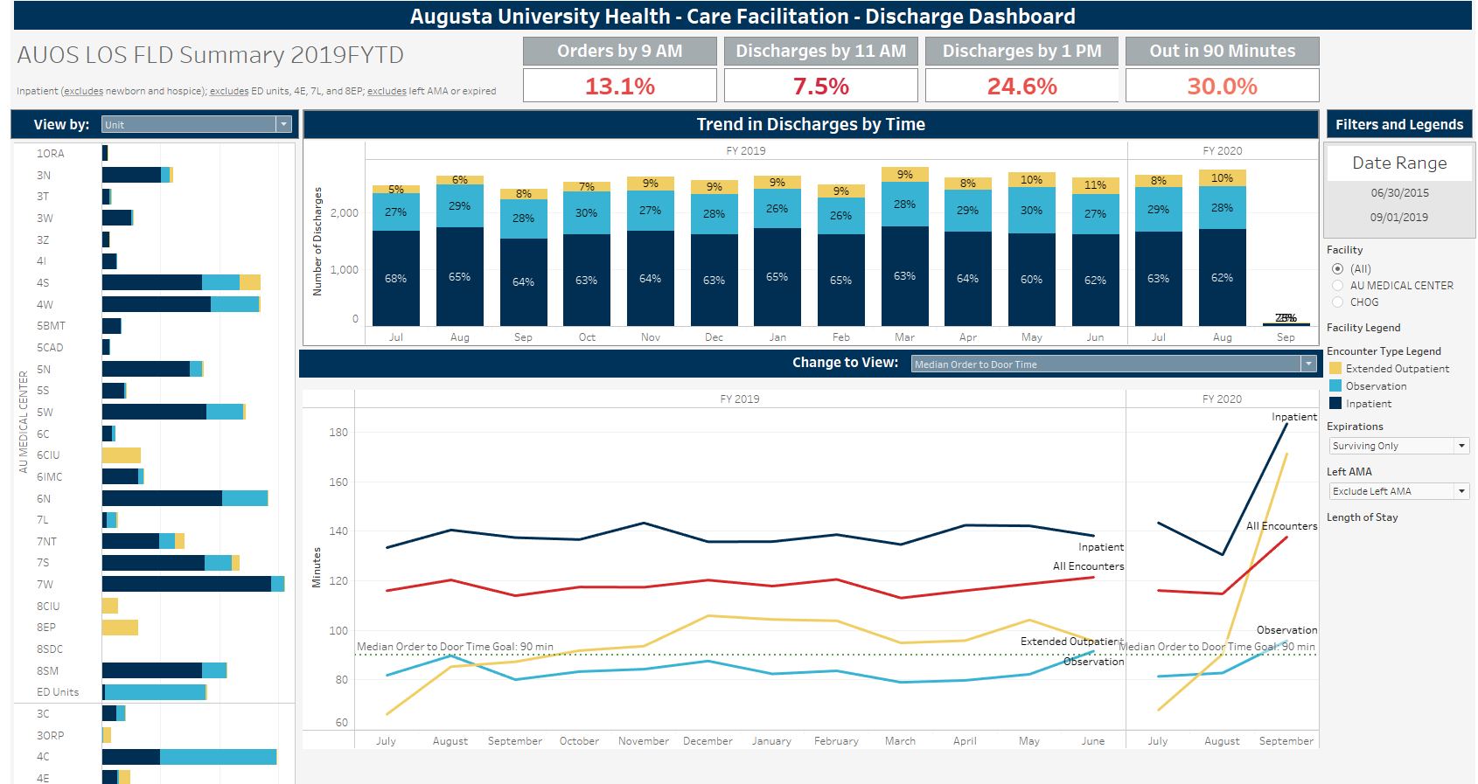
Updated Care Facilitation Dashboard – Tableau Version

Slide 35
Discharge Lounge Supports Throughput
Month/Year

Slide 36
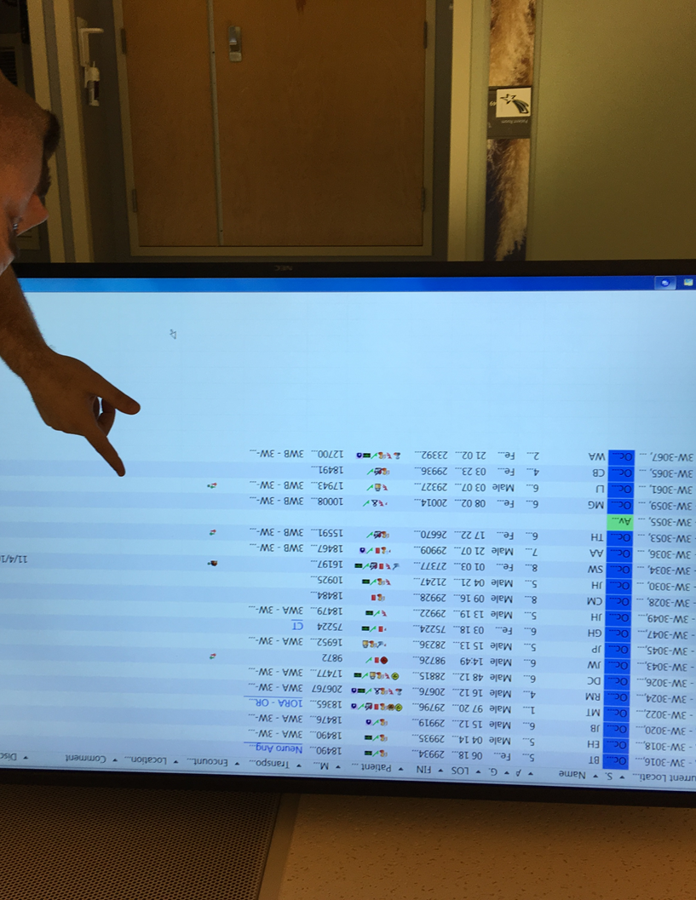
Throughput Initiatives
Staffing Office expanded to 24/7
Float Pool staffing increased
Cerner’s Clairvia implemented
Role of discharge nurse was created
The Meds to Beds program was implemented (current acceptance rate 63%)
Daily Safety Briefing every weekday morning
CareAware Reporting
Administrative Suite – large screen monitors
Cerner Care Management implemented
Bed huddles are now completed daily
CareView Dashboard for unit huddles
Clinical Leader Organizer
Bed Czar position created M-F 12 hours
Discharge Lounge opened
Cerner Patient Observer
Cerner’s Transfer Center solution
Geographic unit design
Increased Nursing Supervisor Coverage
ED Surge Plan

Slide 37
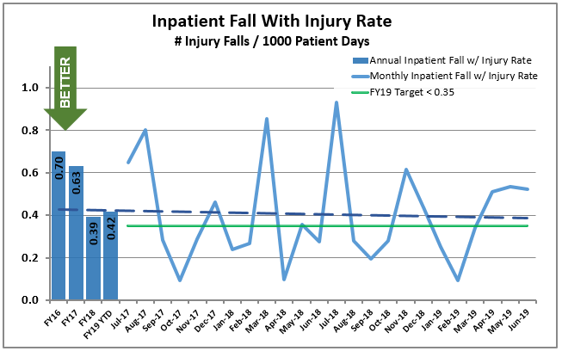
FY 19 Nurse-Sensitive Clinical Indicators

Slide 38
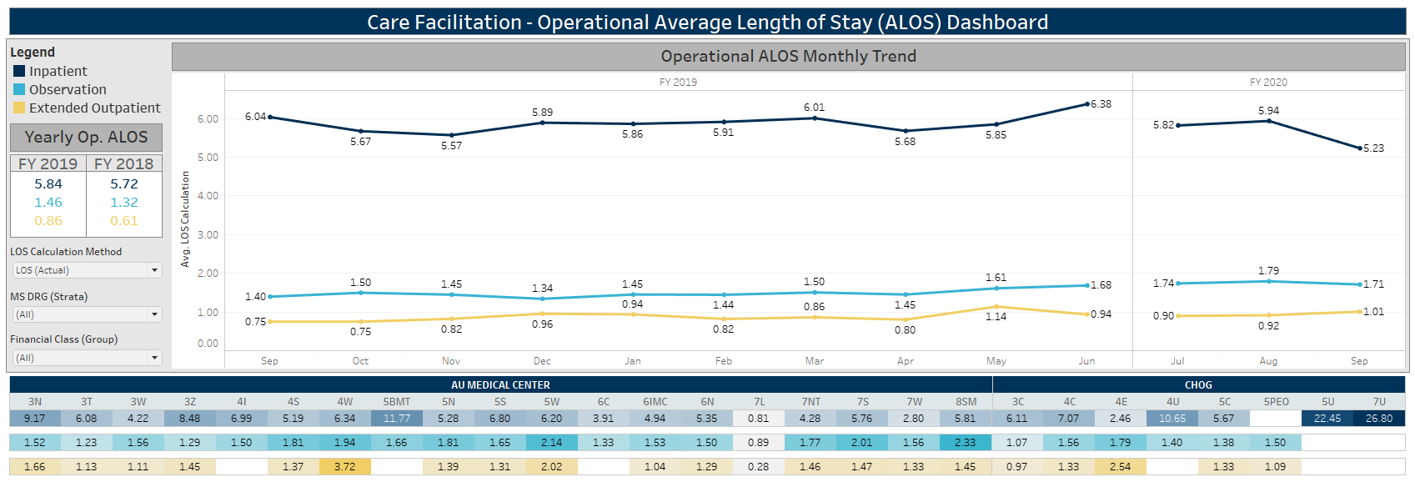
Average Length of Stay FY19 and FY20 YTD

Slide 39
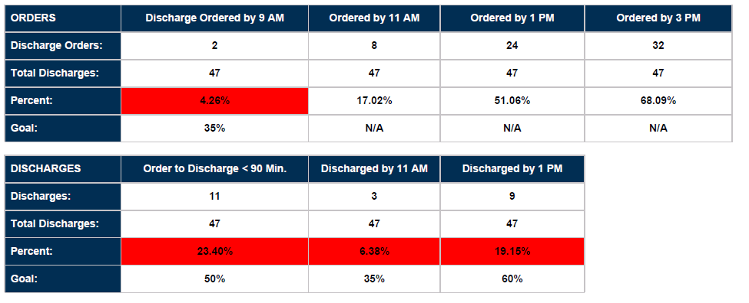
Daily Discharge FLD Summary

